Slide 1
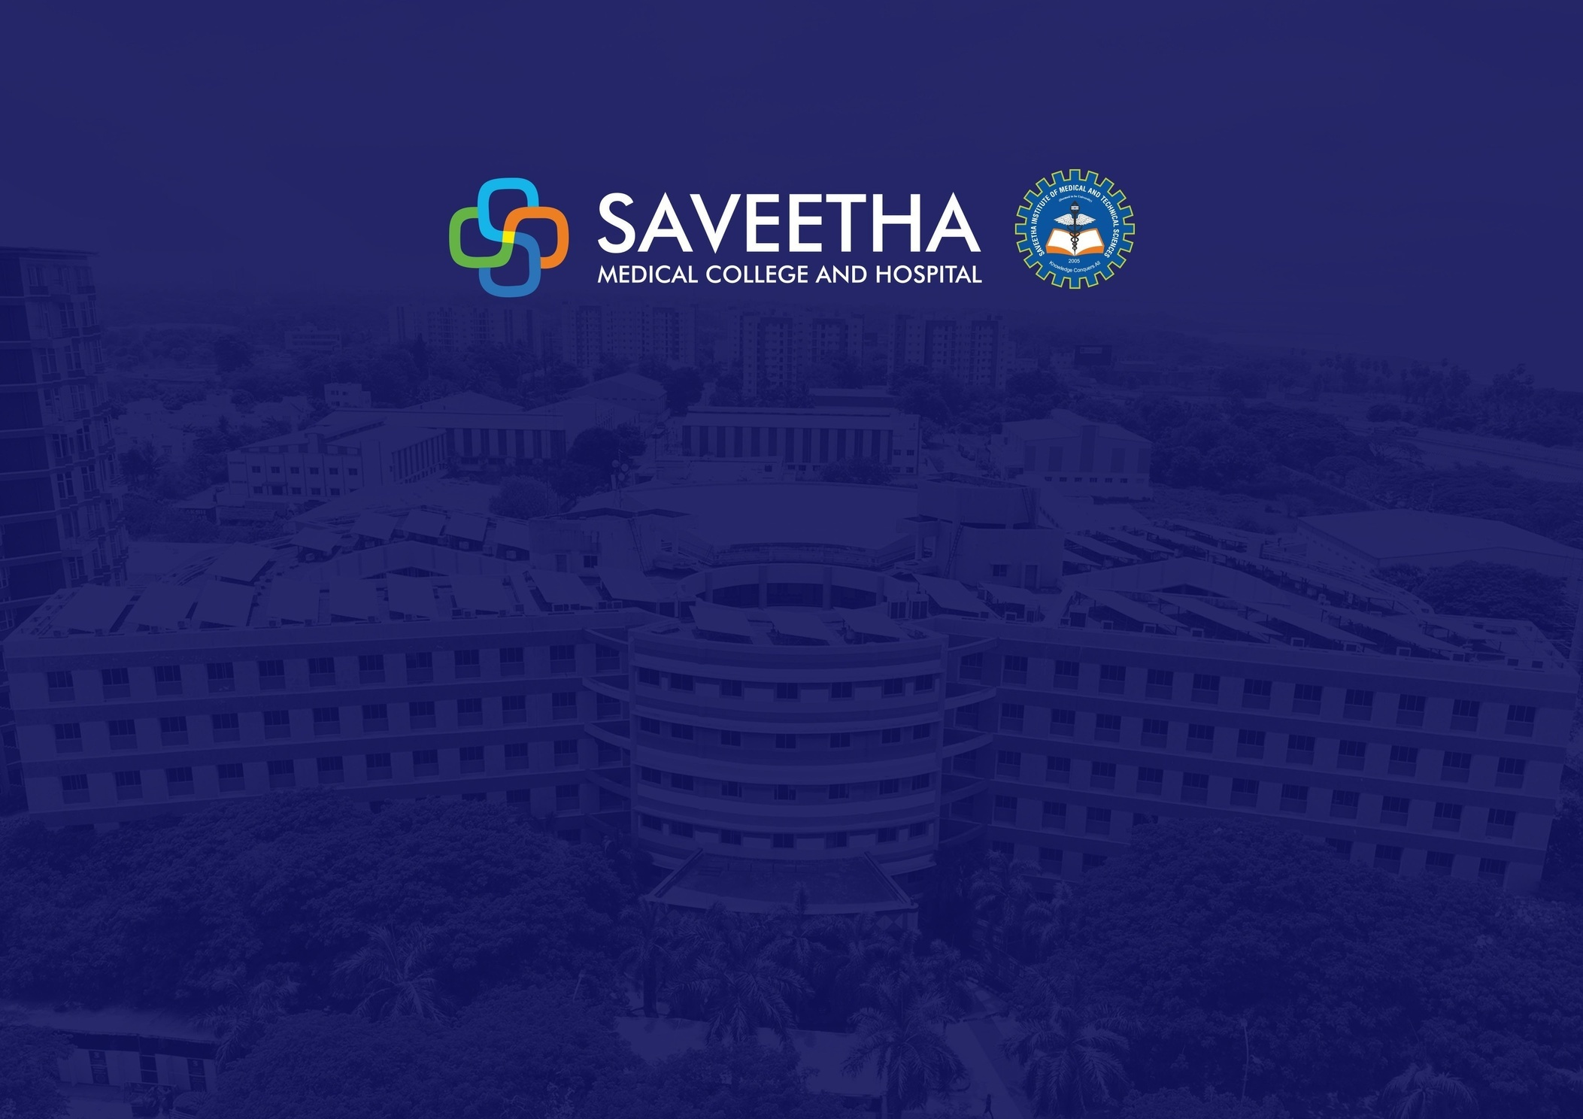
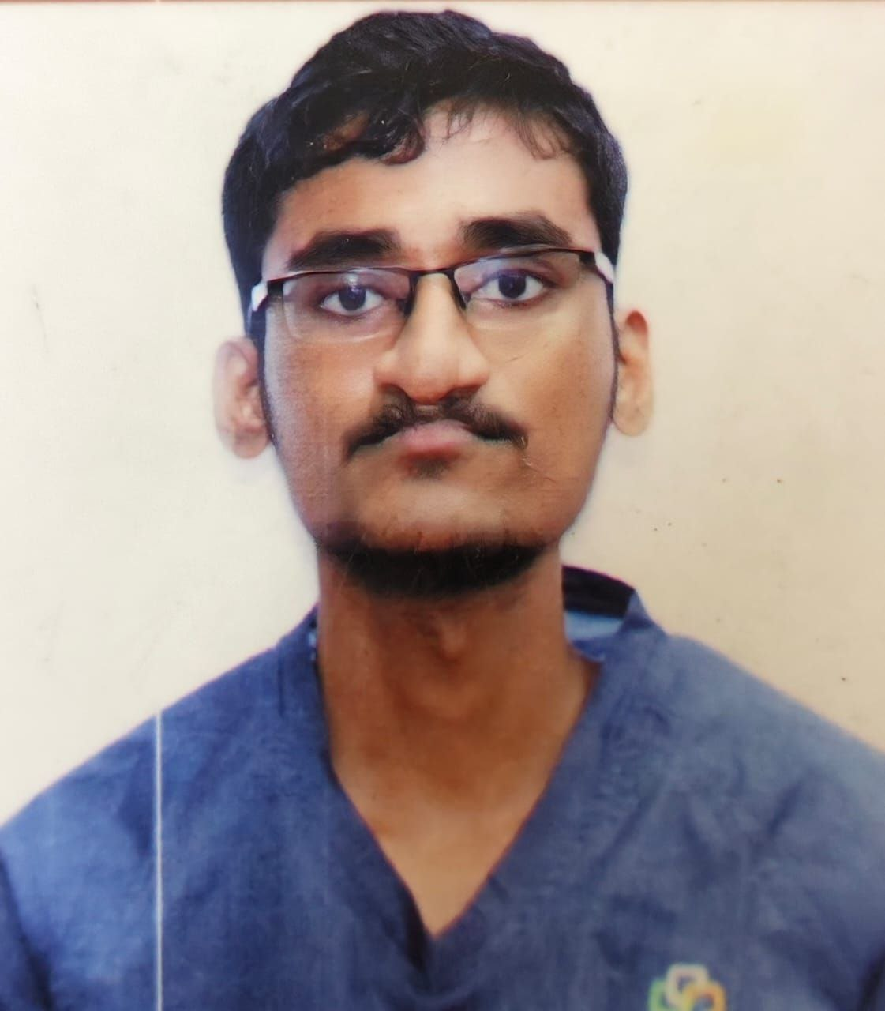
Dr. BALARAM
PROMETHEANS [2020 – 2025]
Saveetha Medical College, Saveetha Institute of Medical and Technical Sciences.

Slide 2
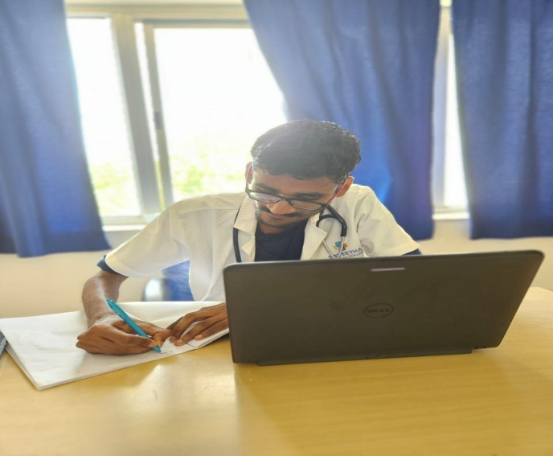
Dr. BALARAM
Bachelor of Medicine, Bachelor of Surgery
PREFACE
PROMETHEANS 2020–2025 | Saveetha Medical College Hospital
Achievements
•
Education is a ray of light in darkness. My vision is to become an academician, thereby impart the right
education and inculcate refined qualities
among the next generation students – simply like a candle
“The good physician treats the disease; the great physician treats the pa4ent who has the disease”
melting itself by providing light to shine. Teaching and demonstration sessions have never failed to amaze
me during my undergraduate program, which encouraged me to work towards becoming an academician
---William Osler
such that I hold the position of a professor/ clinical instructor.
Personal Introduction
I wanted a profession that will satisfy me, challenge me and bring me joy. I believe that a job should be like a hobby – where I want to love my work and know that I am making a diﬀerence in this world by helping others. I know it requires a tremendous amount of patience and hard work. The environment at Saveetha Medical College was simply catalytic in nature which motivated me to go extra mile in every sphere in bringing the best out of me.
•
I believe that the best way to stay mo4vated, is by visualizing one’s achievement & working hard to reach
their goal. I believe that the purpose of life is just not to be happy. it is to be useful, honorable,
compassionate and to have it make some diﬀerence that we had lived and lived well.
“The best way to ﬁnd yourself is to lose yourself in the service of others.”
— Mahatma Gandhi
“A physician is obligated to consider more than a diseased organ, more than even the whole man—he must view the man in his world.”
I am fortunate to have grown in a very compe44ve environment in my medical school which has kindled me to always keep working harder and use this freedom righteously to raise my standards as a professional and as a good human rather than be another conven4onal physician.
— Harvey Cushing

Slide 3
Phase 3B
1 |
Page
SAVEETHA MEDICAL COLLEGE HOSPITAL

Slide 4
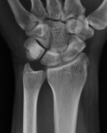
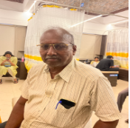

Student Name: BALARAM.S
A case of dequervains tenosynovitis
Reg. no: 112001035
S.no: 1 PID: 240904241778
Name: Velusamy N Age: 75 Gender: Male
Brief Clinical History:
Chief complaints: Pain over the bilateral thumb finger for past 1 month
H/O Presenting Illness: Patient was apparently normal before 1 month after which he developed pain over the thumb finger for past 1 month, sudden in onset, progressive in nature, aggravating on motorcycle riding and reliving on rest. H/o pain radiating to wrist, weakness of the right and left foot. No h/o crepitus, fever, no loss of joint movement.
Past History: No h/o T2DM, TB, TB CONTACT, thyroid disorder, hypertenion, surgical procedures
Workup:
Bp- 114/80 mmhg, RR- 16/min, Spo2-98%,pulse-82bpm
General examination- Normal
Patient was conscious, oriented to time, place and person
Orthopaedic examination:
Site: bilateral thumb finger bilateral
Palpation: Tendernes present at right MCP joint of first dorsal compartment
Range of motion -: Thumb flexion - 80° Thumb extension - 10° Thumb abduction - 50°
Muscle power: Thumb abductor- 3/5 Thumb adductor -3/5 Thumb MCP flexor-3/5 Thumb IP-3/5 Wrist flexor- 4/5 Wrist extensors 4/5
Finkelstein test +ve
RS ; NVBS, trachea appears to be in midline, equal chest movements, no wheeze
Abdomen: soft, non tender, no organomegaly
CNS : no focal neurological deficit
CVS: S1S2 heard, apical impulse seen on 5th intercoastal space
=
Differential diagnosis / Clinical insights :
Osteoarthritis of the first carpometacarpal joint
Intersection syndrome
Wartenberg's syndrome
Trigger thumb
Management / Procedure done:
Patient was advised to take xray wrist and hand
Tab. Zerodol TH max BD for 5 days
Tab. Pan 40mg OD for 5 days
Tab. Mymi d OD for 5 days
Physiotheraphy: UST was advised
3 |
Page
SAVEETHA MEDICAL COLLEGE HOSPITAL

Slide 5
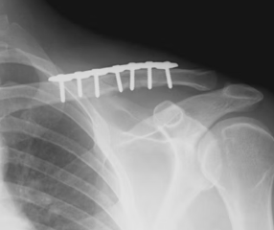
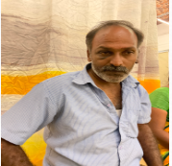
Student Name: BALARAM.S
A case of right clavicular fracture
Reg. no: 112001035
S.no: 2 PID: 240307185251
Name: Sundaraiah V Age: 43 Gender: Male
Brief Clinical History:
Chief Complaint:
Patient came for post op review of right clavicular fracture for past 3 months following accident
History of Presenting Illness: Patient came for post op review of right clavicular fracture for past 3 months following accident. No h/o fever, vomiting, nausea, LOC, Vomitting,ENT bleed, seizures or any other joint pain.
Past Medical History: No h/o hypertension, TB, seizure, T2DM, thyroid disorder
Workup:
Bp- 114/80 mmhg, RR- 16/min, Spo2-98%,pulse-82bpm
General examination- Normal
Patient was conscious, oriented to time, place and person
Orthopaedic examination:
Site: right closed displaced mid third shaft of clavicle fracture
Swelling present over clavicular region
Tenderness present over mid 3rd clavicle
ROM – Painful and restricted
Sensation intact
Radial artery pulsation felt
Arm, Elbow, Forearm, wrist and hand – Clinically normal
RS ; NVBS, trachea appears to be in midline, equal chest movements, no wheeze
Abdomen: soft, non tender, no organomegaly
CNS : no focal neurological deficit
CVS: S1S2 heard, apical impulse seen on 5th intercoastal space
Differential diagnosis / Clinical insights :
Acromioclavicular joint injury
Rib fracture
Scapular fracture
Shoulder dislocation
Rotator cuff injurY
Management / Procedure done:
Patient was admitted and planned for ORIF+PO with lateral end Clavicle plate
Xray clavicle was taken and shows healing progress
cBC shows normal hb: 14.7 mg/dl
Tab. Myospaz forte BD for 1 week
3 |
Page
SAVEETHA MEDICAL COLLEGE HOSPITAL

Slide 6
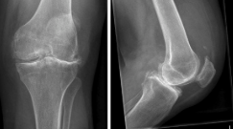
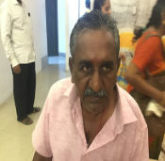
Student Name: BALARAM.S
A case of knee osteoarthritis
Reg. no: 112001035
S.no: 3 PID: 240222180563
Name: Nagendran M Age: 63 Gender: Male
Brief Clinical History:
CHIEF COMPLAINTS:Patient came with complaint of left knee pain for past 10 days
HISTORY OF PRESENTING ILLNESS: Patient came with complaint of left knee pain for past 10 days, sudden in onset progressive in nature aggravating on night and no relieving factors. H/o swelling over the region, pain over the phalanges, crepitus. No h/o shoulder pain, headache
PAST MEDICAL / SURGICAL HISTORY: Patient is a known case of knee osteoarthritis for past 3 months, known case of diabetes/ Percutaneous Nephrolithotomy is done
Workup:
Bp- 126/80 mmhg, RR- 16/min, Spo2-98%,pulse-82bpm
General examination- Normal
Patient was conscious, oriented to time, place and person
Orthopaedic examination:
Site: Left knee , Swlling+, crepitus+, Stiffness over joint+
Palpation: Tenderness: grade 1 medial aspect of knee
Range of motion -: Knee flexion - 135 Knee extension - 135 to 0
Muscle power: Knee flexors - 5/5 Knee extensors - 4/5
Patella apprehension test positive Patella grinding test / Clarke's sign position VMO weakness present MPFL laxity/ weak present
RS ; NVBS, trachea appears to be in midline, equal chest movements, no wheeze
Abdomen: soft, non tender, no organomegaly
CNS : no focal neurological deficit
CVS: S1S2 heard, apical impulse seen on 5th intercoastal space
Differential diagnosis / Clinical insights :
Rheumatoid arthritis
Psoriatic arthritis
Psoriatic arthritis
Septic arthritis
Meniscal tear
Management / Procedure done:
Patient was advised to take xray left knee AP/lateral
Xray shows narrow joint space, osteocytes, subchondral sclerosis
Tab. Jointache DM OD for 15 days
Tab. Combiflam BD for 5 days
Tab. Pan 40mg for 5 days
Diclo gel
3 |
Page
SAVEETHA MEDICAL COLLEGE HOSPITAL

Slide 7
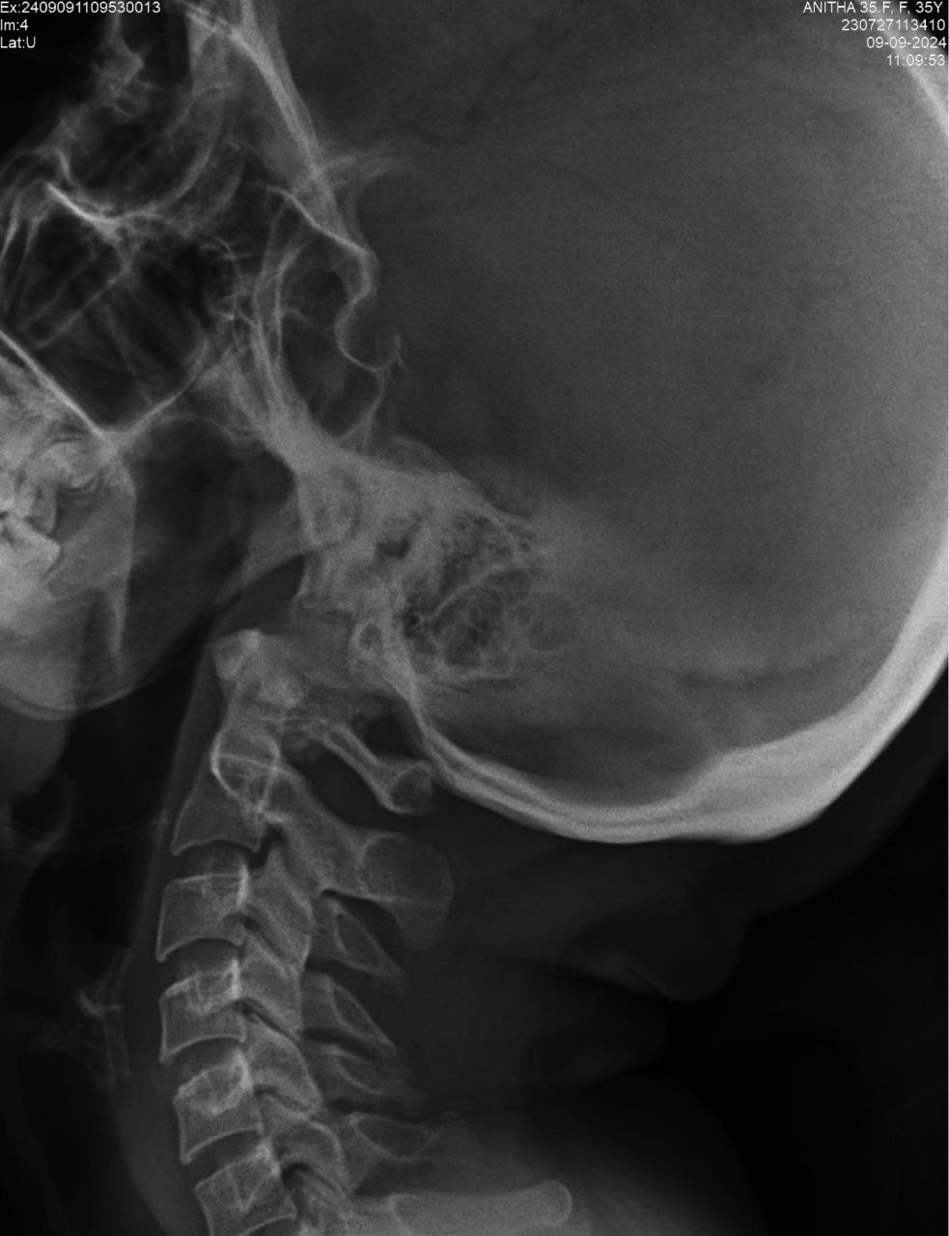
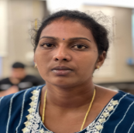
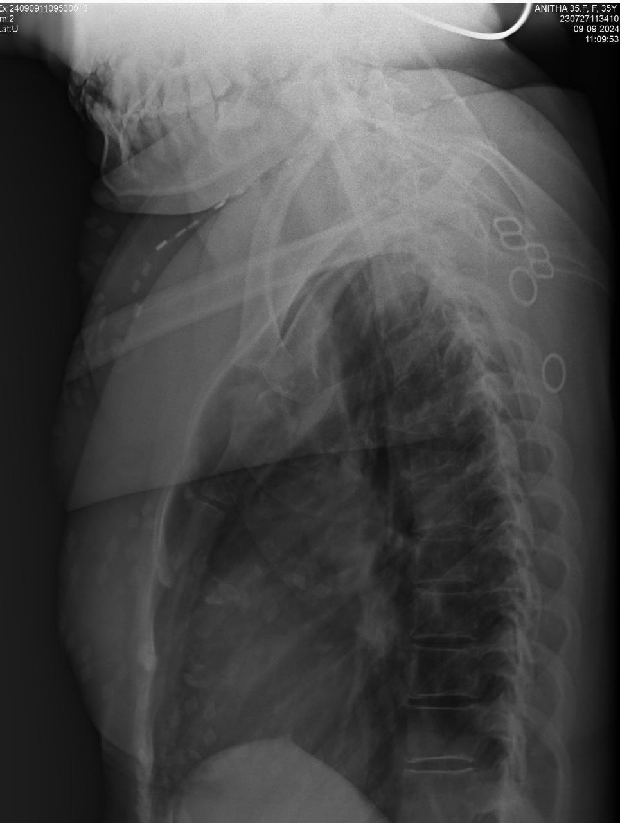
Student Name: BALARAM.S
A case of spondylosis
Reg. no: 112001035
S.no: 4 PID: 230727113410
Name: ANITHA H Age: 35 Gender: Female
Brief Clinical History:
Chief complaints: Patient came with complaint of giddiness for past 1 year Complaint of neck pain for past 6 months
H/O Presenting Illness: Patient was apparently normal before 1 year after which she developed giddiness for past 1 year, insidious in onset, progressive in nature, aggravating during work and relived on rest. H/o neck pain which is radiating to right shoulder stiffness over the fingers and toes present on early morning, headache( frontal region). No h/o fever, cough,ear and throat complaints, palpitations, chest pain.
Workup:
Bp- 90/60 mmhg, RR- 16/min, Spo2-98%,pulse-82bpm
General examination- Normal
Patient was conscious, oriented to time, place and person
Orthopaedic examination:
Site: neck (upper trapezius)
Side : Right
On Palpation:
Tenderness present over neck region
Range of motion -: Optimal AROM available
RS ; NVBS, trachea appears to be in midline, equal chest movements, no wheeze
Abdomen: soft, non tender, no organomegaly
CNS : no focal neurological deficit
CVS: S1S2 heard, apical impulse seen on 5th intercoastal space
Differential diagnosis / Clinical insights :
Muscular strains and sprains
Degenerative disc disease:
Spinal canal stenosis
Osteoid sarcoma
Rheumatoid arthritis
Management / Procedure done:
Patient was advised to take Xray cervical spine ap / lateral; Xray thoracic spine ap / lateral
Patient was advised to take iron rich food.
Patient was also advised to do neck strengthening exercises
3 |
Page
SAVEETHA MEDICAL COLLEGE HOSPITAL

Slide 8
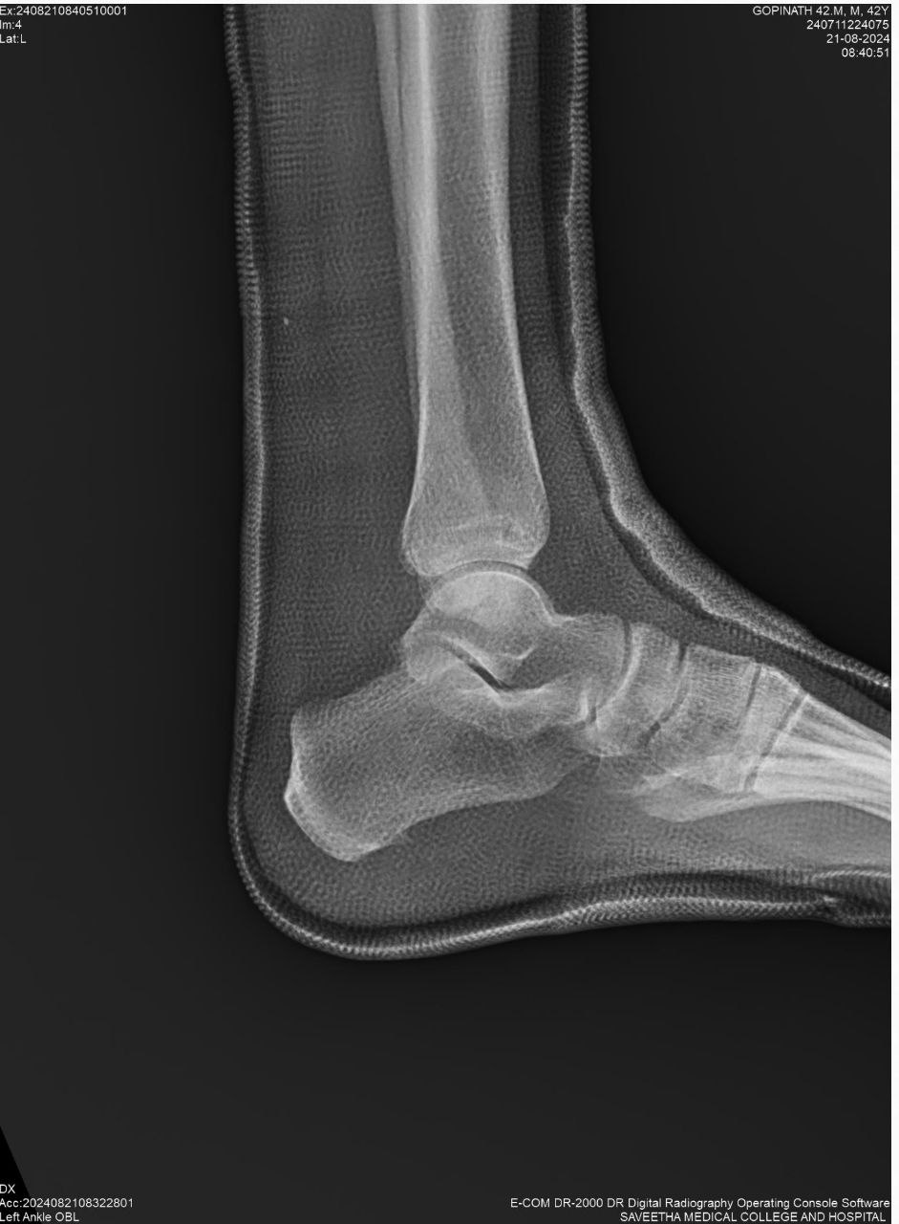
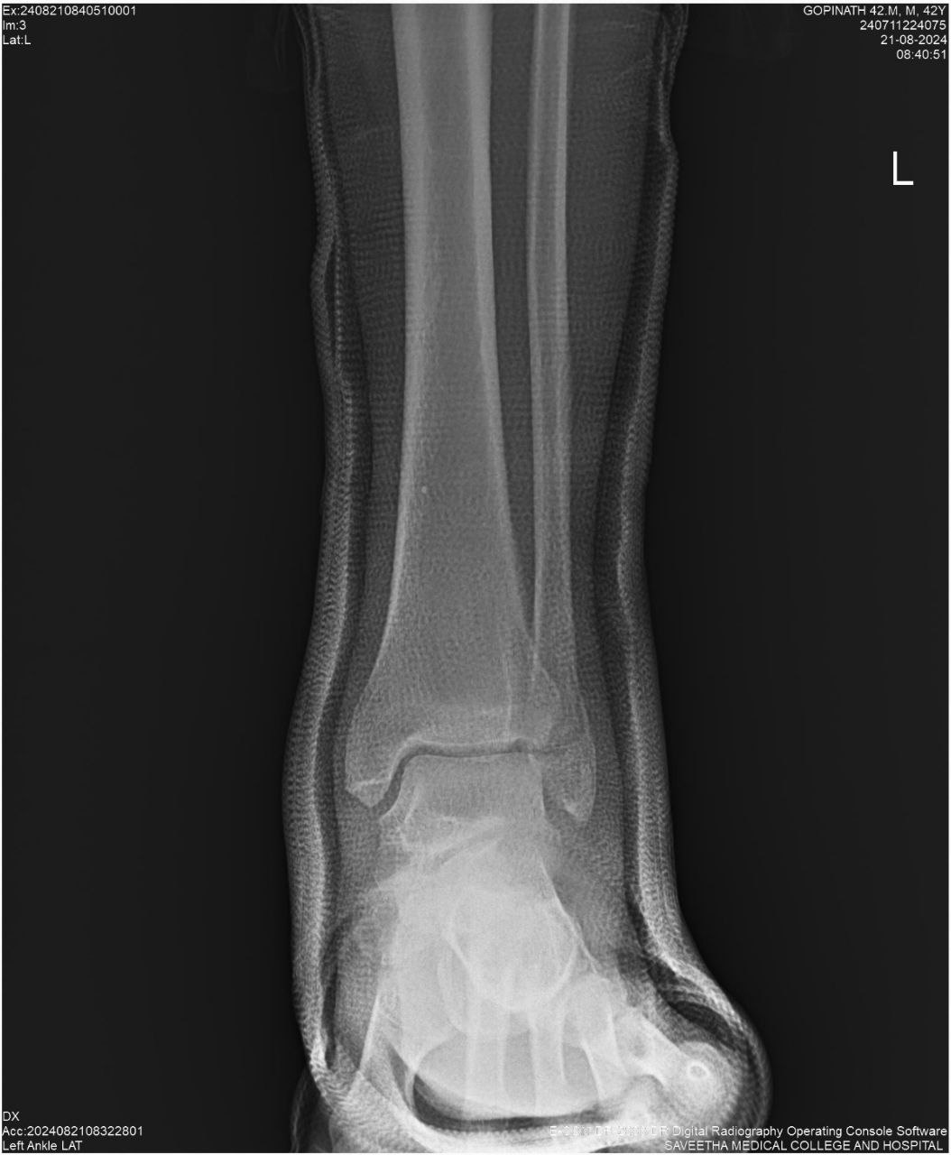
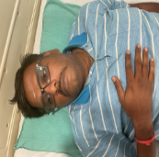
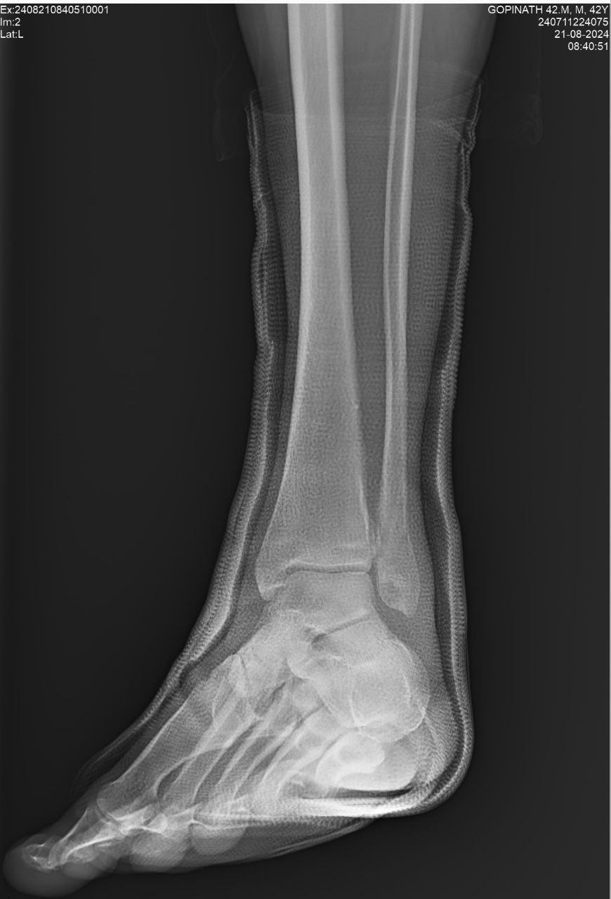
Student Name: BALARAM.S
A case of left lateral malleolar fracture
Reg. no: 112001035
S.no: 5 PID: 240711224075
Name: Gopinath B Age: 42 Gender: Male
Brief Clinical History:
Chief complaints:
Patient came for case removal for closed left lateral malleolar fracture
H/O Presenting Illness: Patient came for case removal for closed left lateral malleolar fracture
No h/o pain, swelling, loss of gait, loss of sensation
Past History: K/c/o T2DM for 6 years Angioplasty done in 2019
Personal History: Normal sleep normal bowel and bladder movements mixed diet
Workup:
Bp- 110/80 mmhg, RR- 16/min, Spo2-98%,pulse-82bpm
General examination- Normal
Patient was conscious, oriented to time, place and person
Orthopaedic examination:
Site: left lateral malleolar
SWELLING+
TENDERNESS PRESENT OVER LATERAL MALLEOLUS
ROM PAINFUL AND RESTRICTED
NO DNVD
RS ; NVBS, trachea appears to be in midline, equal chest movements, no wheeze
Abdomen: soft, non tender, no organomegaly
CNS : no focal neurological deficit
CVS: S1S2 heard, apical impulse seen on 5th intercoastal space
Differential diagnosis / Clinical insights :
Ankle sprain
Osteoarthritis
Achilles rupture
Tendon dislocation
Rheumatoid arthritis
Management / Procedure done:
Patient was advised to take X-RAY ankle three views – left
On Xray: healing of bones were present
Removal of plaster of paris was done
Tab Tolydol 1-0-1 x 5 days
Tab Ranitidine 150 mg 1-0-1 x 5 days
Tab CHYMORAL Forte 1-1-1 x 5 days
3 |
Page
SAVEETHA MEDICAL COLLEGE HOSPITAL

